Slide 1
Studio/portrait lighting techniques The are several different types of lighting/shadowing that are tried and true methods. Each varies with subjects bone and/or facial structure and each technique will not work for everyone Some common lighting setups for portraiture: Rembrandt Split Lighting Loop Lighting Butterfly Clean/professional studio Low Key Studies

Slide 2
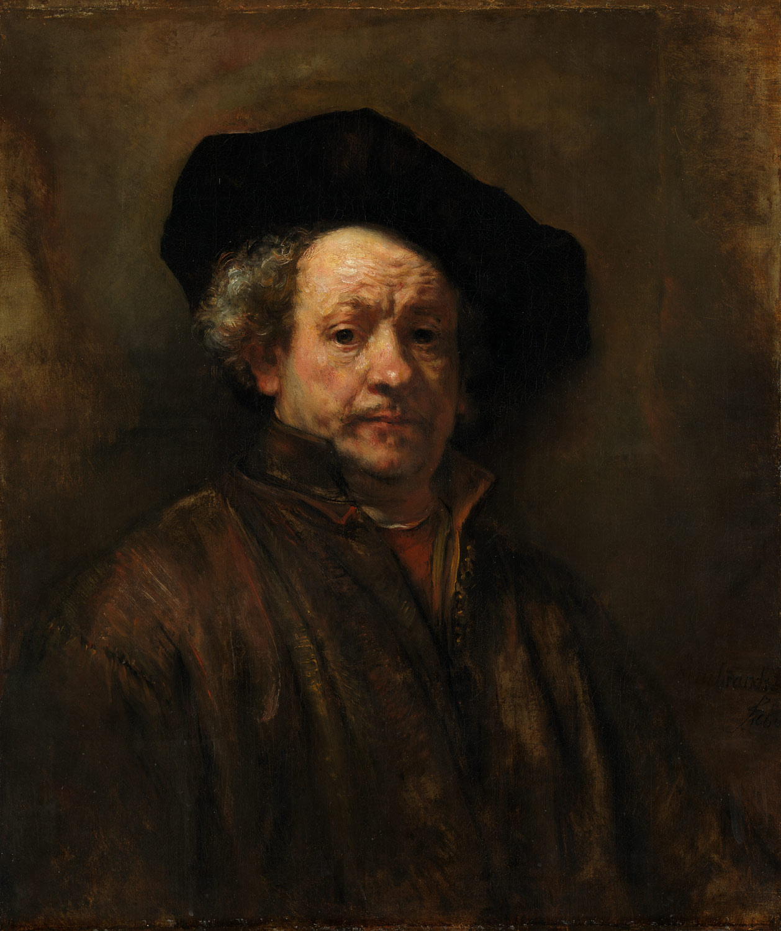
Rembrandt lighting

Slide 3
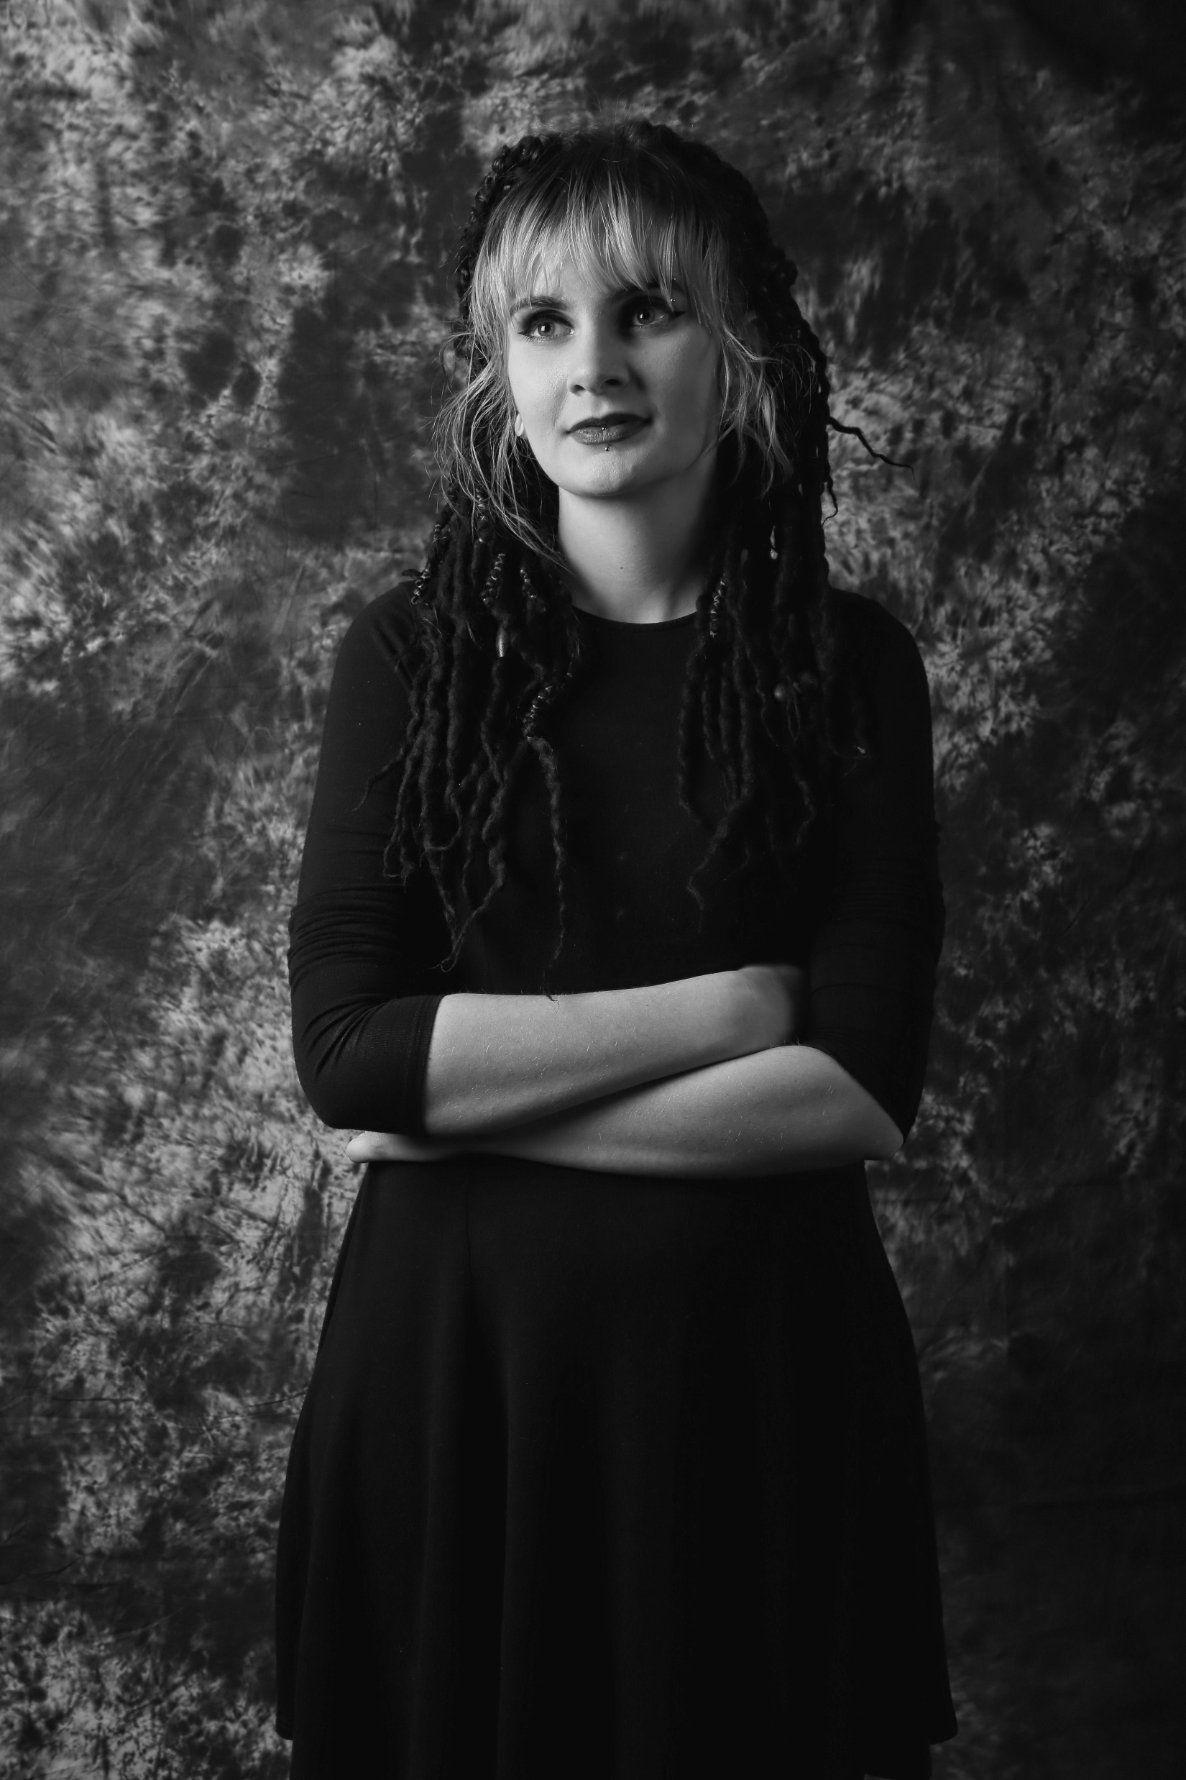
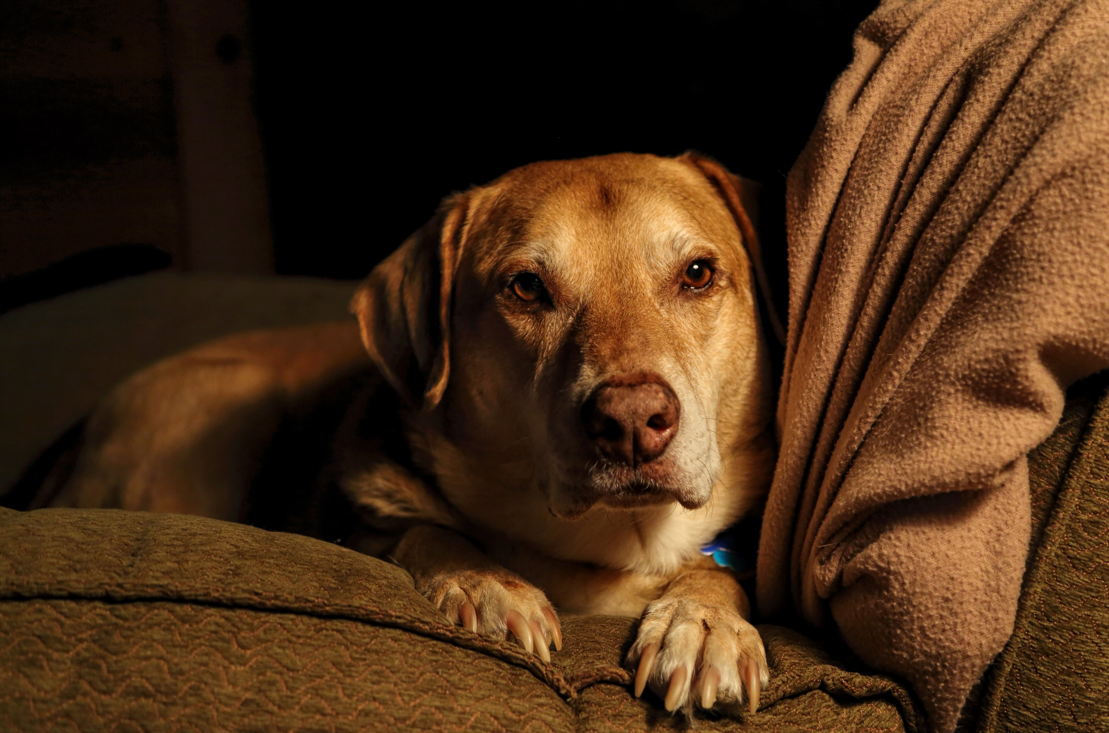
Rembrandt lighting examples

Slide 4
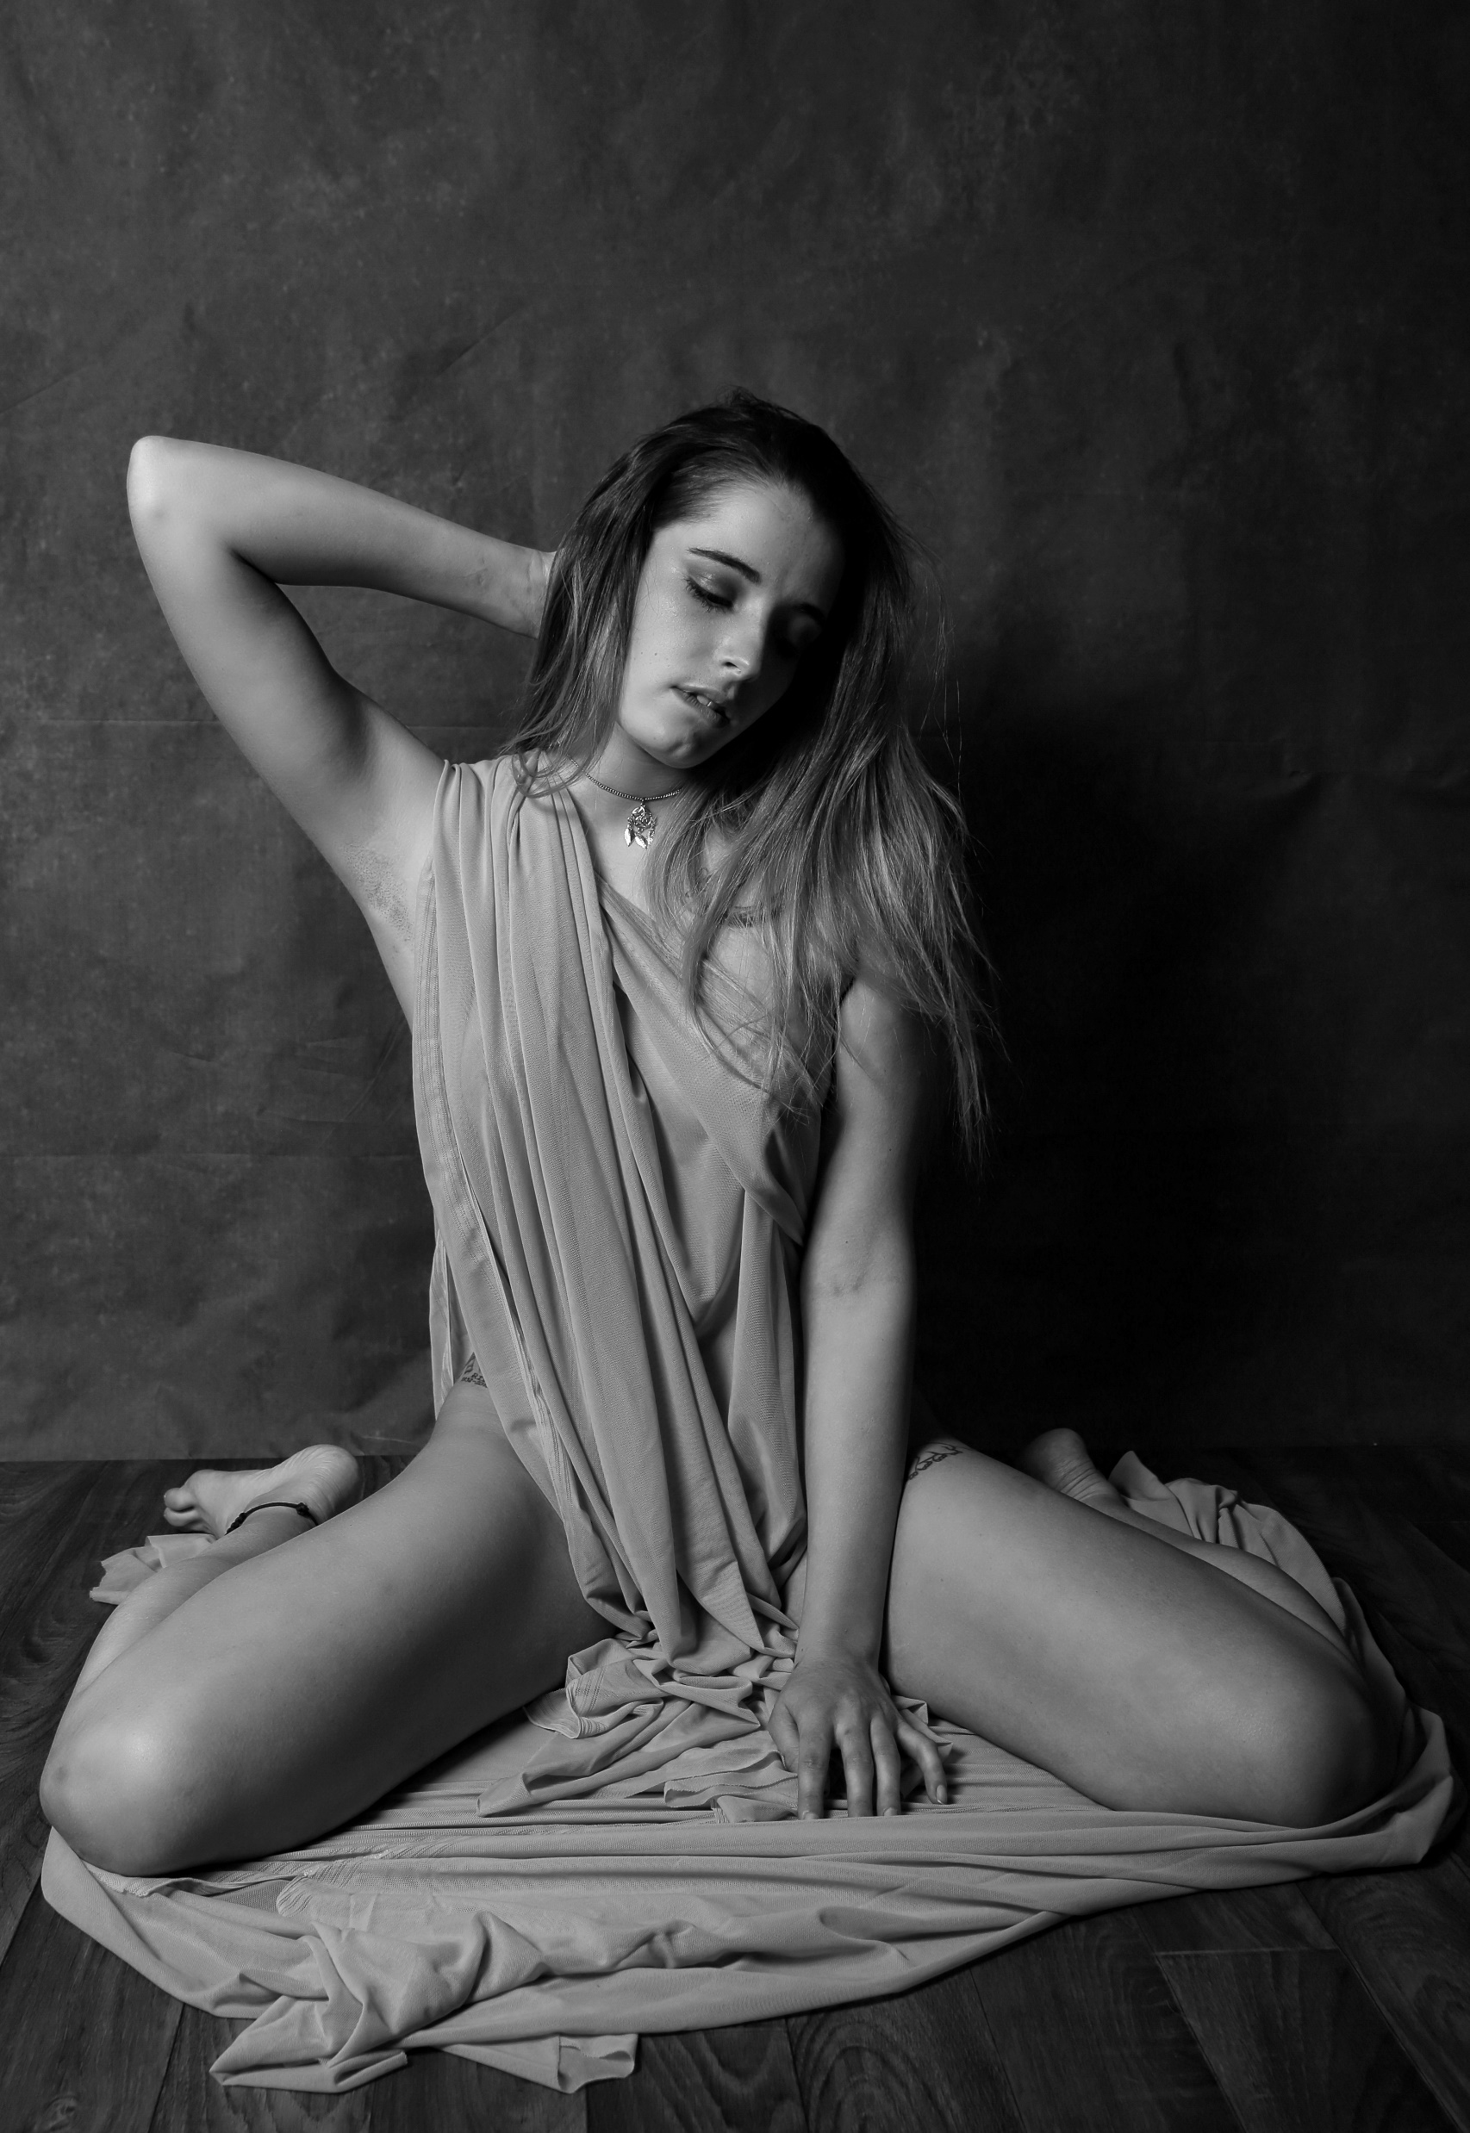
Split lighting Just what the name implies. The subject is split in two with the light casting a pleasing shadow on the other half

Slide 5
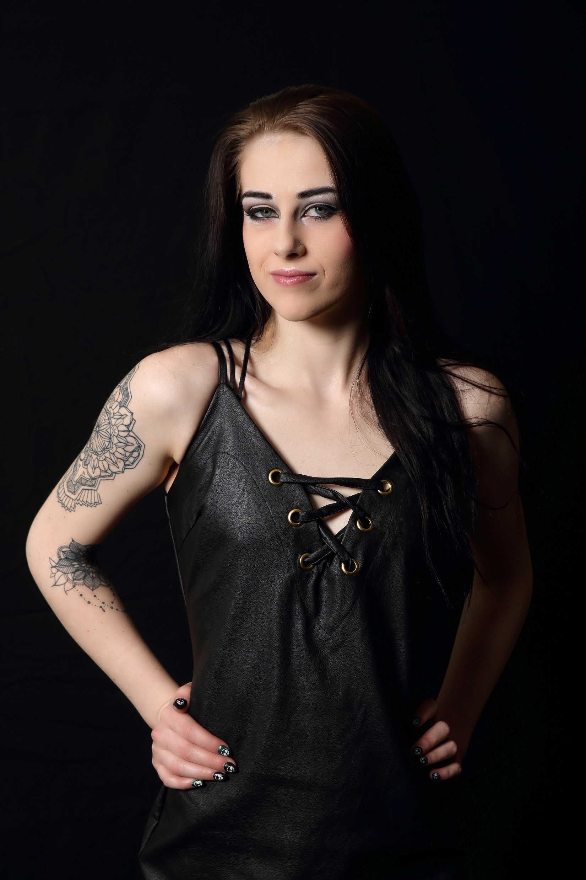
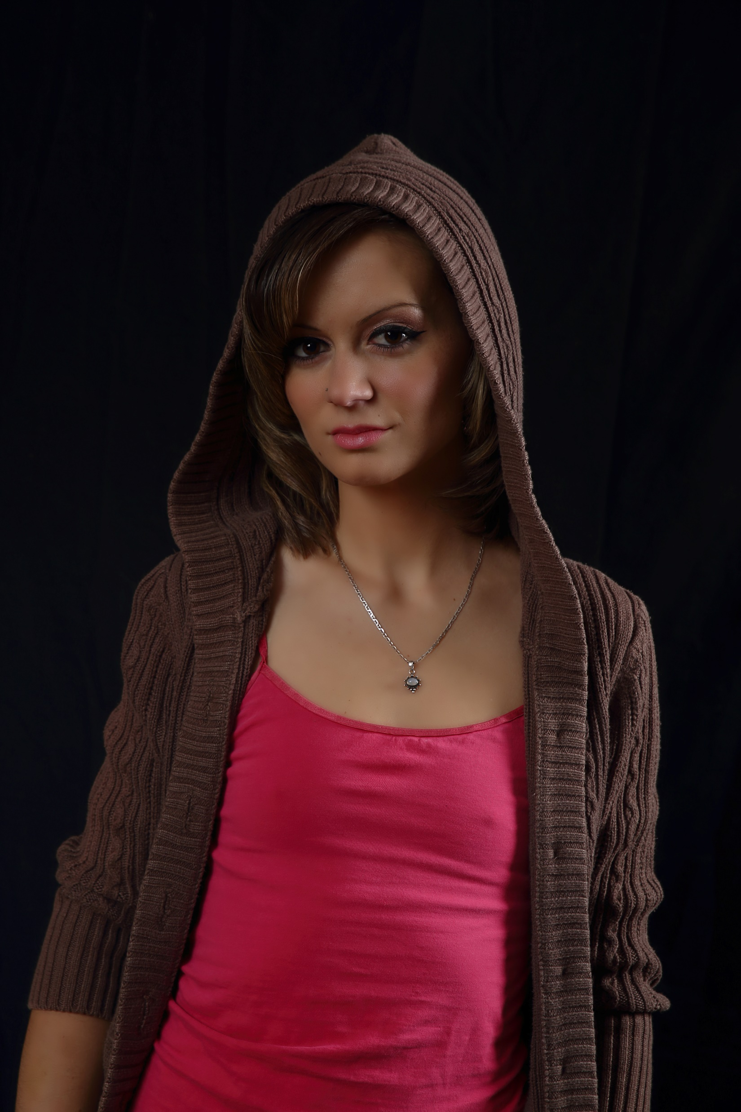
Loop Lighting

Slide 6
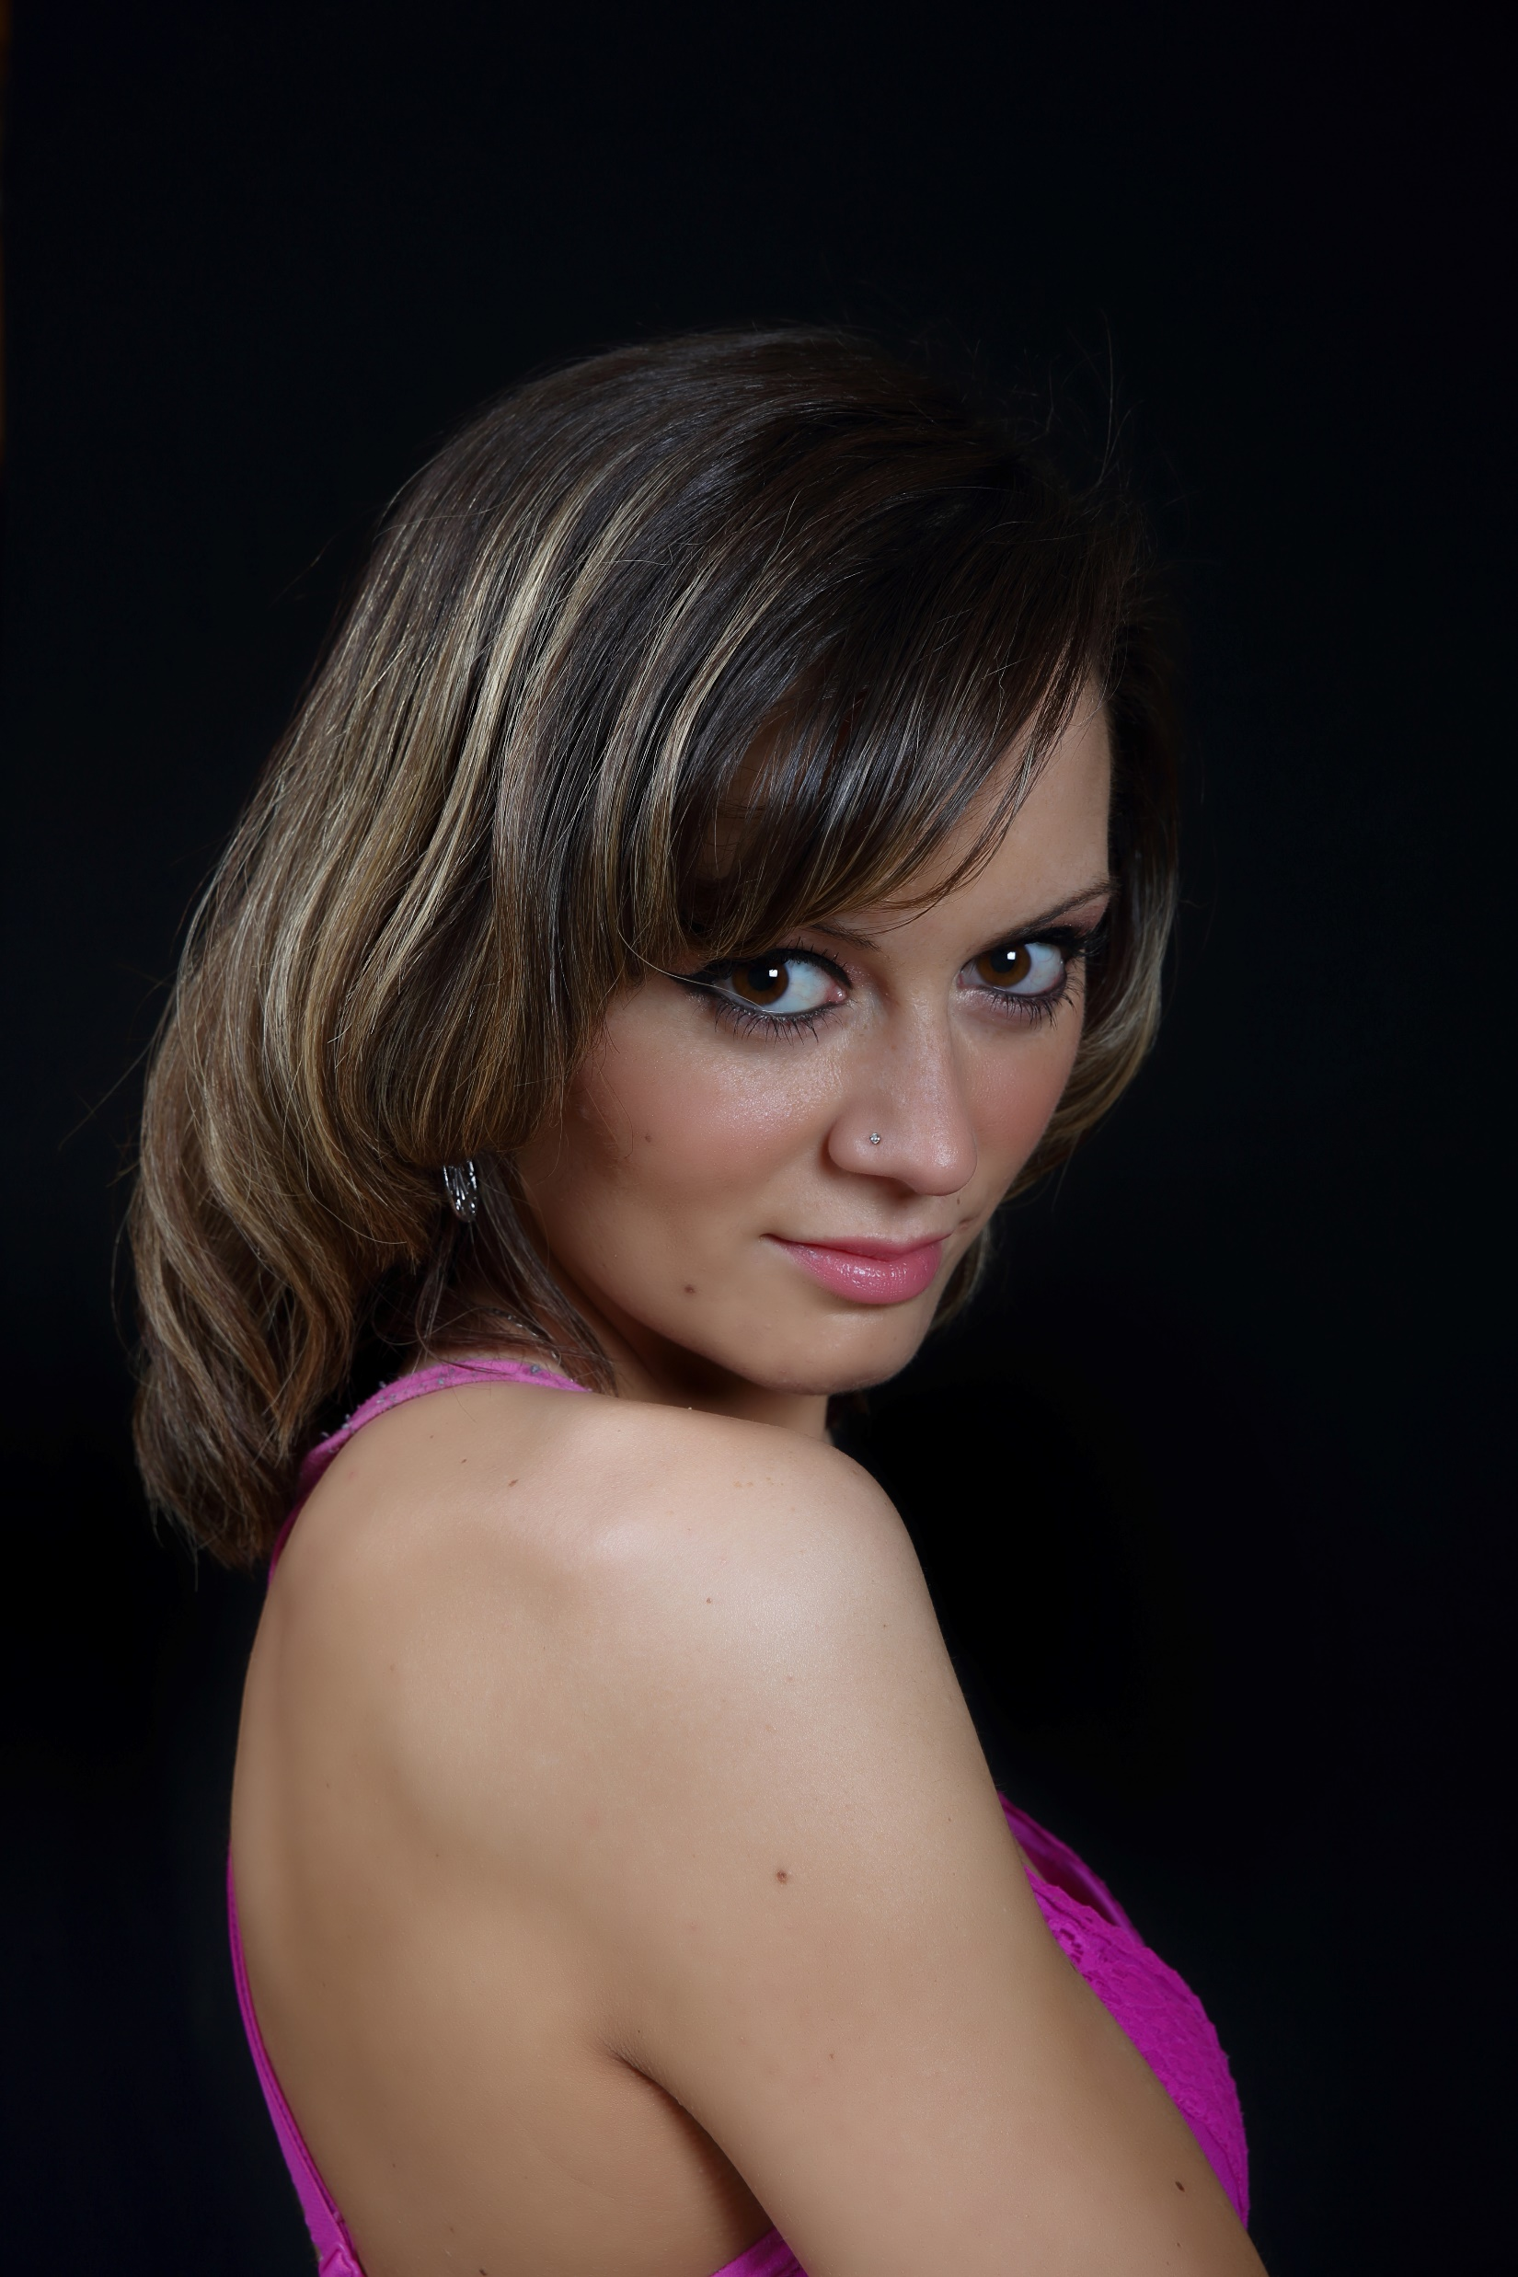
Butterfly Lighting

Slide 7
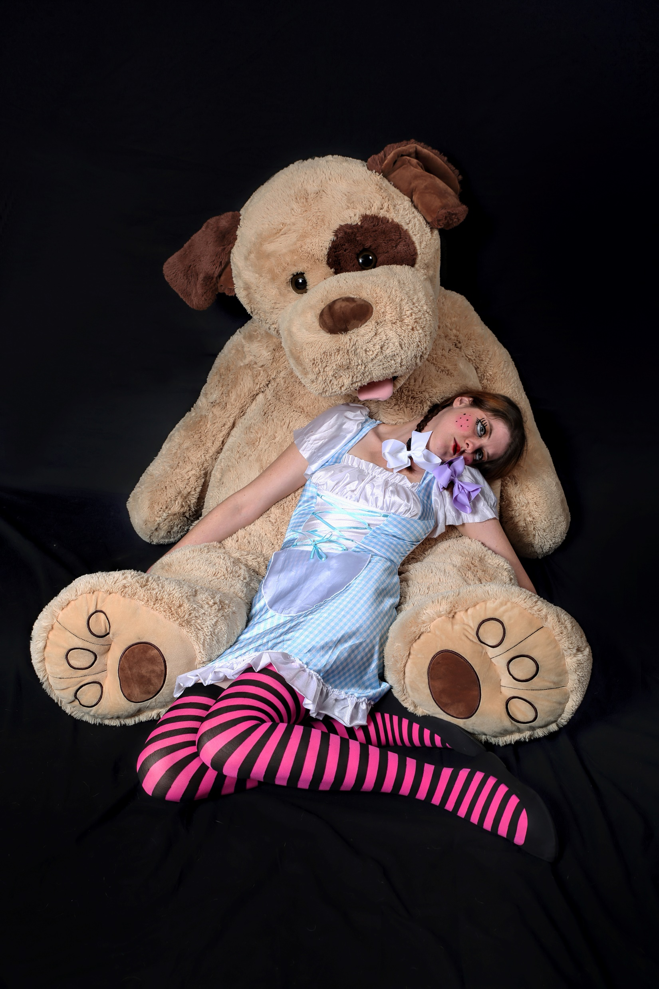
Clean studio lighting

Slide 8
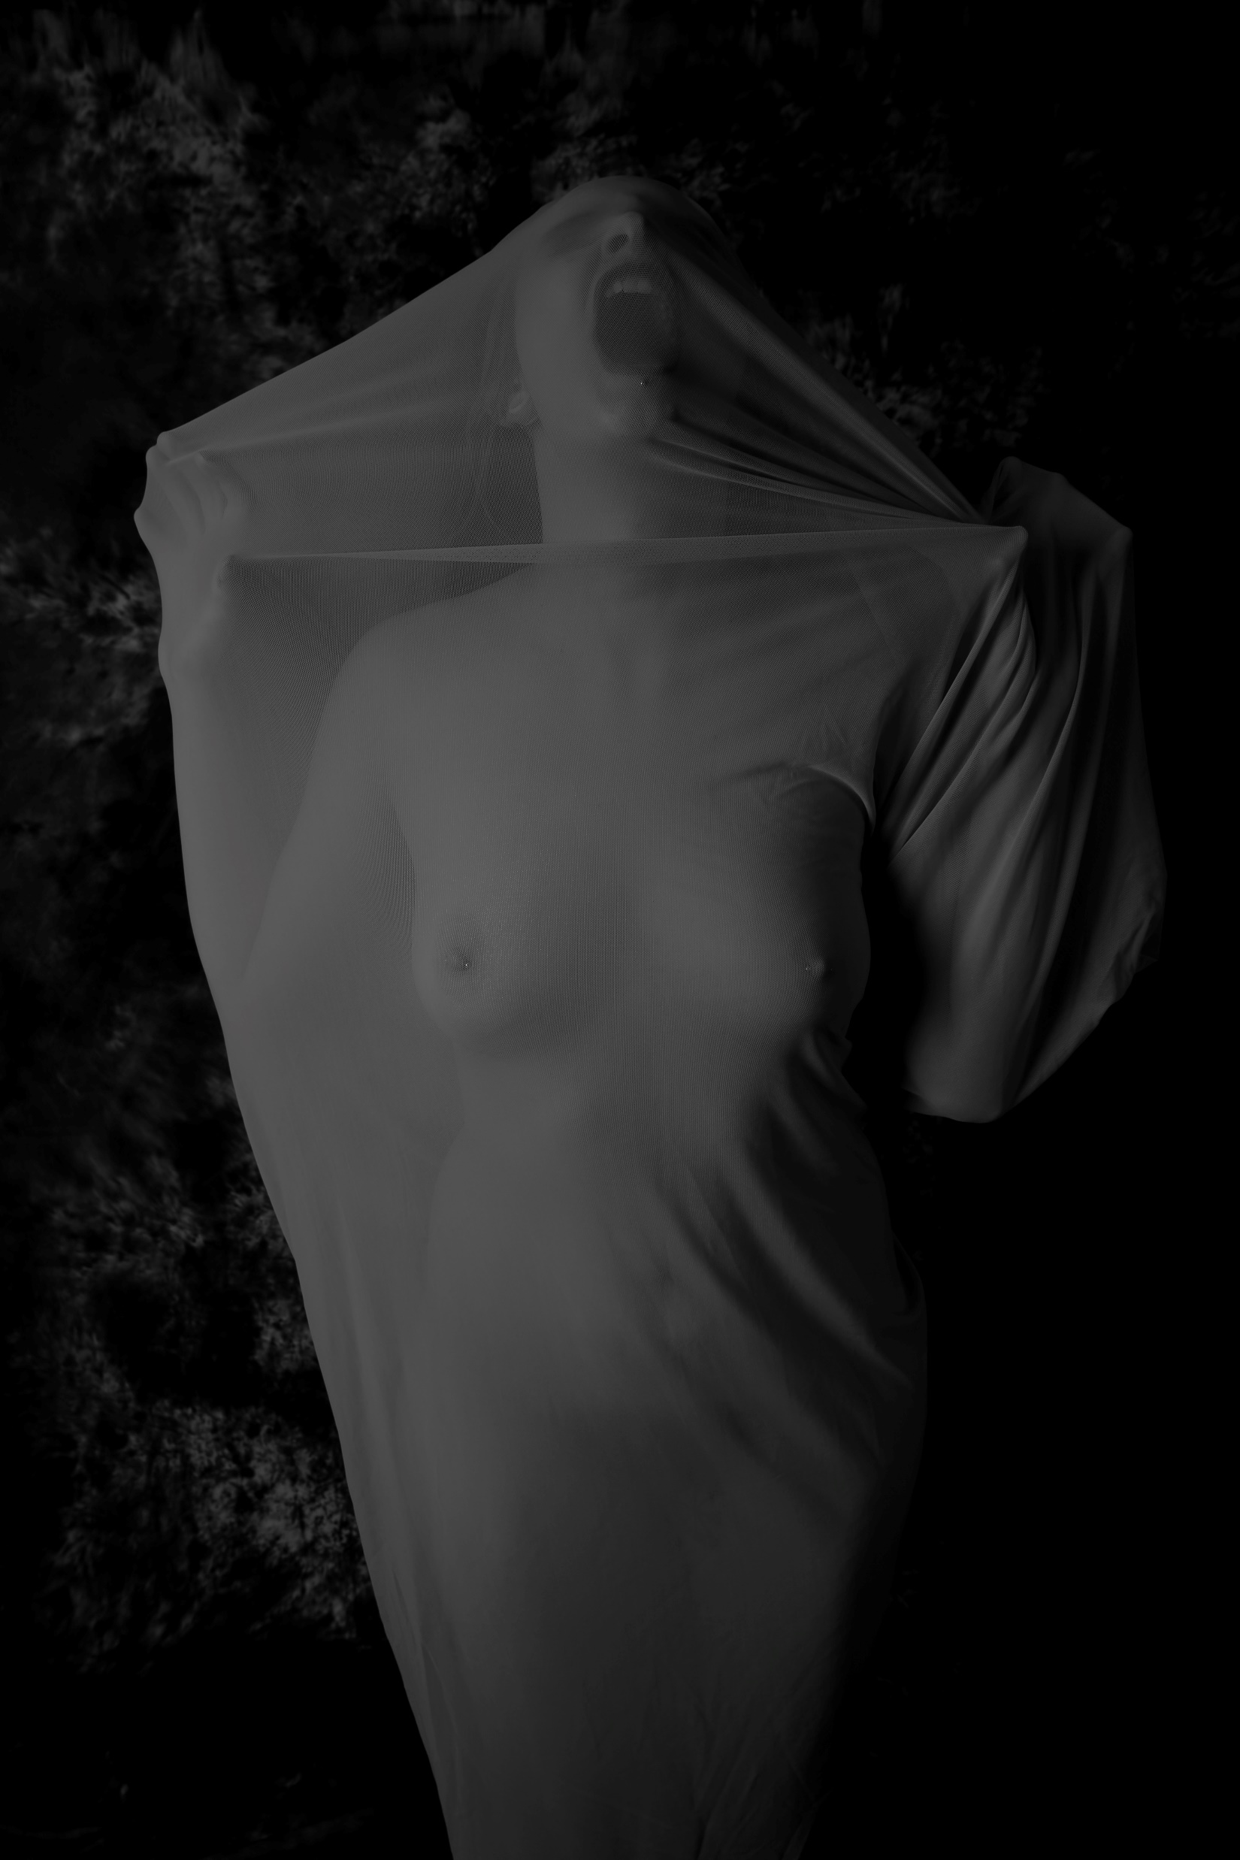
Low Key Studies with light

